Slide 1
HMC Membership Meeting
New Process for Billing Water
April 11, 2015

Slide 2
History
WA State mandate to install water meters and implement conservation measures
New water delivery system construction completed in 2012 and funded by USDA loan beginning in May 2013
Individual meters installed at each assessable unit
A full year of monthly meter readings was collected for each water connection. (Some members have multiple water connections)
HMC water connections – 402 total (5 HMC – 397 Member)
JP

Slide 3
The Facts
HMC is a Washington State Non-Profit Corporation. We cannot make a profit from our water revenues, but income from billings must be sufficient to sustain our water system operating costs.
Annual Water Budget will determine water billing rates and may vary from year to year.
Water will continue to be billed quarterly based on your average usage and tiered at different levels to meet state conservation regulations.
A Base Fee will apply to all water connections to cover operating costs, including Reserves now and into the future.
JP

Slide 4
The Numbers
Tiered Water Usage – Average Daily Gallons per Month (ADG/M)
Base Fee: 0 to 150 ADG $ 18.00 per month
Tier 1: 151 to 400 ADG $ .07 per ADG/month
Tier 2 401 to 800 ADG $ .14 per ADG/month
Tier 3 Over 801 ADG $ .21 per ADG/month
Average Daily Gallons per month will be used to calculate usage because the number of days between meter readings can vary each month.
JP

Slide 5
The Numbers
Base Fee includes:
Wages for administration and HMC Water Distribution Manager
Repair and maintenance costs (including labor)
Contract manager including monthly water testing (NW Water Systems)
Billing and mailing costs
Electrical costs
Excise taxes
Insurance
State reporting requirements
Reserves
Reserve Study requirements
Legal fees
Auditor Costs
JP

Slide 6
How We Developed the Usage Tiers
The data collected over the last year revealed wide fluctuation levels of usage across the membership. (Full time members vs. part time members and summer time vs. winter time provided the total picture.)
The Base Fee was established using all water membership connections and includes the first 150 gallons of consumption . The goal was to establish fair rates for a diverse population of water users.
Three tier levels were created based on real usage data taking into consideration that higher water consumption should be billed at a higher rate to encourage conservation.
State mandated conservation requirements dictate the need for these tiers.
JP

Slide 7
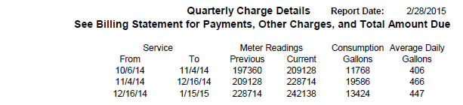
Water Charge Detail
FF

Slide 8
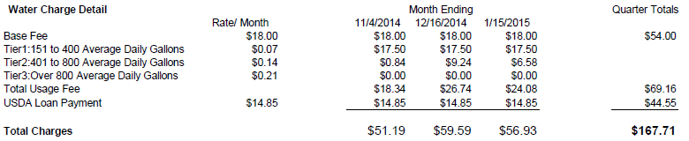
Water Charge Detail
FF

Slide 9
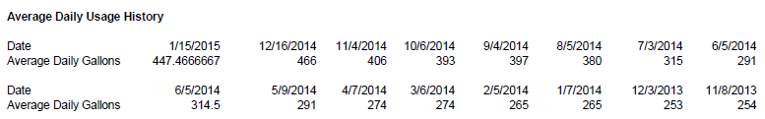
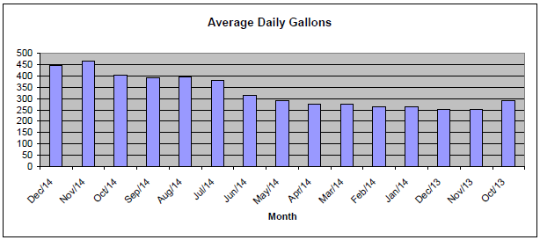
Water Charge Detail
FF

Slide 10
Water Charge Detail
Charge detail will also contain:
HMC Member number
Water connection/s and service addresses
Your actual monthly water consumption
Time period this water usage covers
USDA Loan fee - $44.55 (if applicable to your Membership)
Charted usage history
FF

Slide 11
Quarterly Water Bill
Your quarterly water bill could also contain other charges (if applicable):
For example:
Past Due charges
Hook-up Fees
Late Fees
Shut off Fees
Etc.
NOTE: The total amount due will be shown on your Billing Statement
FF

Slide 12
Reminder
Water bills carry the same obligations as regular or special assessments. Members are subject to late fees if payment is not received by the due date. Water payment delinquencies are handled the same way as other delinquencies and can result in denial of ferry access in accordance with the established delinquency policy as defined in HMC governing documents.
JP

Slide 13
Questions?
JP

